Slide 1

Arabic letter recognition and pronunciation evaluation
Akouz Ismail
Internal Supervisor: Dr. Abderrahmane Ezzahout External Supervisor: Dr. Karim Bouzoubaa
President: Dr. Yahya Benkaouz
Master IDDL
1

Slide 2
Introduction What is the program? What does it do? How does it work?
2

Slide 3
Our Target
Our main target is for children elementary school students, Non native children even the blind children.
3

Slide 4

Aims and problems we solved
Little work is done for Arabic speech recognition especially for kids.
The teaching problems with E-learning.
Letting them pronounce well.
Games are the fun way to learn.
4

Slide 5
Methods and Tools
We used Python language, Matlab and C# for Unity Engine.
We used Tensorflow and Keras framework and used in Matlab Deep Learning Toolbox and Audio Toolbox.
5

Slide 6
The models we used
Our CNN layers.
Alexnet.
Vgg16 use transfer learning with and without tuning.
Yamnet use transfer learning.
6

Slide 7

The methods we used to build the recognition system
Collected the data set for the 28 Arabic letters.
Pre-processed the audio dataset.
Split the audio dataset to train, test and validation sets.
Extract features from the audio and store them in a JSON file.
We had 2 form of datasets one is MFCCS.
The second one is mel-spectrogram.
Then we used these data as inputs for the models we used and built.
Then trained the model with different epochs and batch size and learning rate.
7

Slide 8
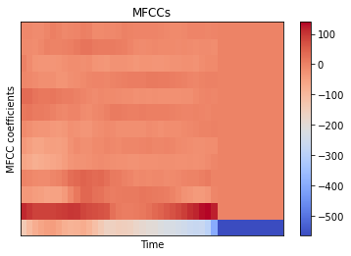
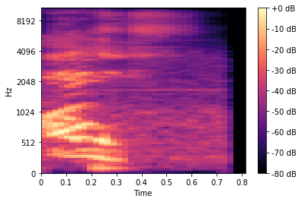

Slide 9
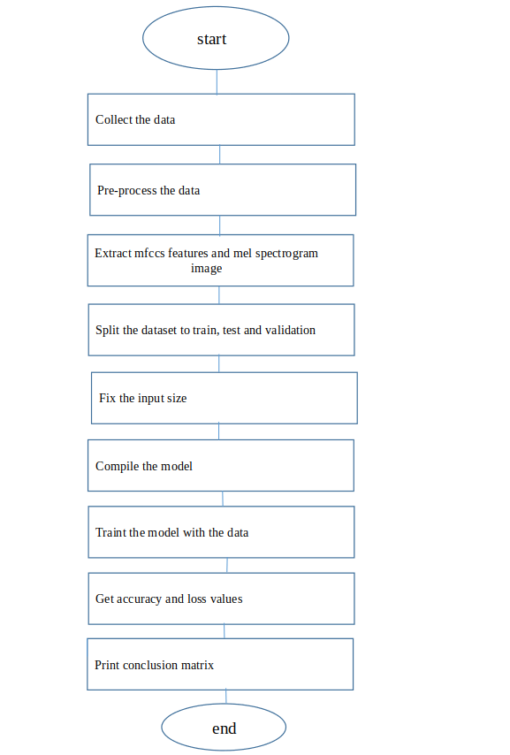
The flowchart show the steps to make the CNN models:

Slide 10

The methods to use recognition system
Sound pre-process.
Extract features.
Load the model.
Input the sound.
Evaluate the prediction.
Get the output which is text.
Compare text with the correct transcription.
10

Slide 11
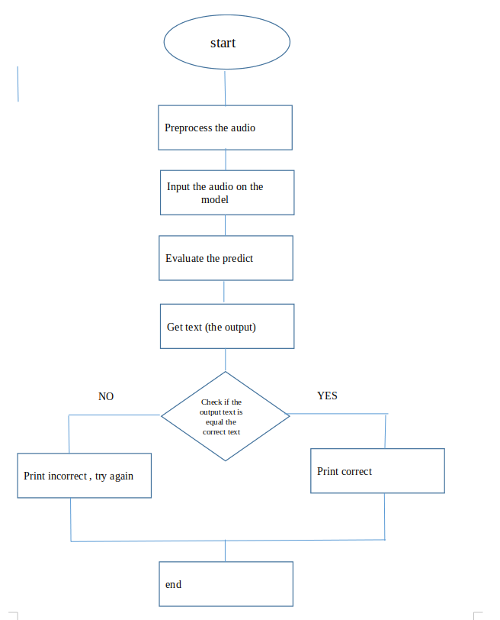
The flowchart for how to use this model to check if the pronounce is correct or not:

Slide 12
Results
The result of training differs from model to another, they vary from good to bad results.
12

Slide 13
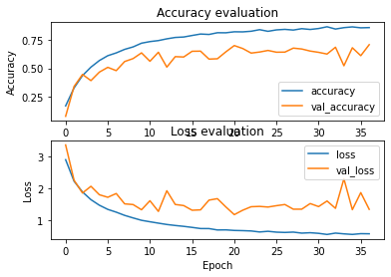
CNN
74% test accuracy

Slide 14
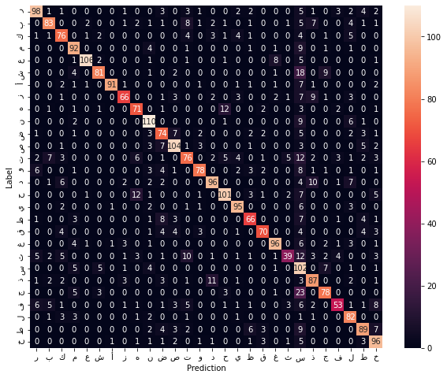
CNN

Slide 15
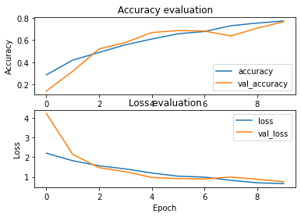
Alexnet
55% test accuracy

Slide 16
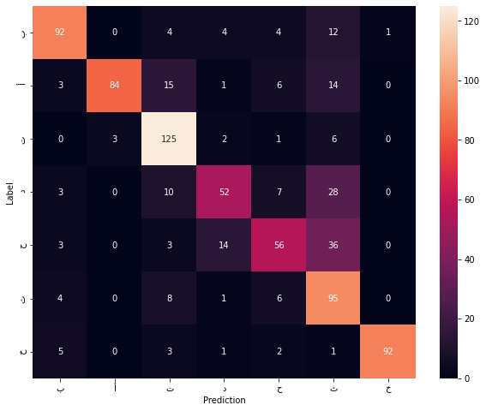
Alexnet

Slide 17
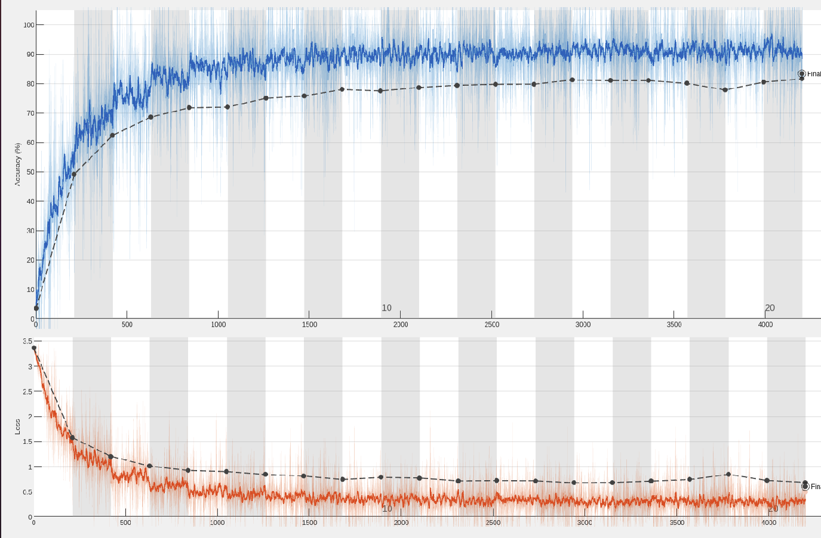
Yamnet
83.47% test accuracy

Slide 18
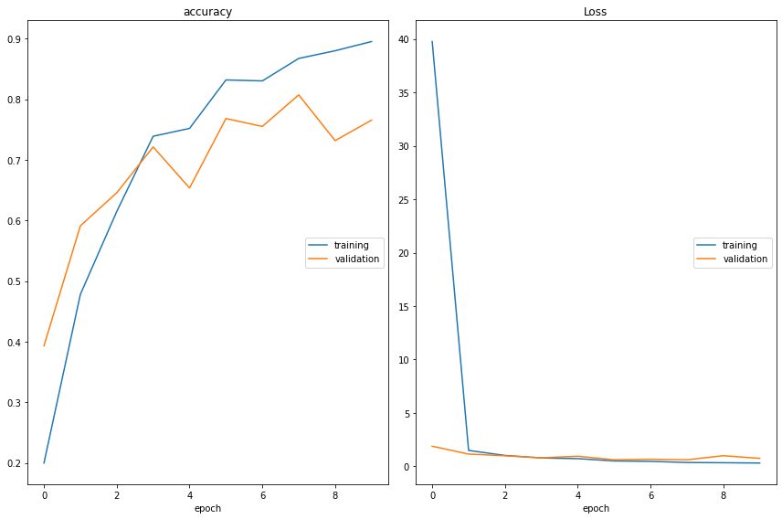
Vgg16 - without tuning
77.94% test accuracy

Slide 19
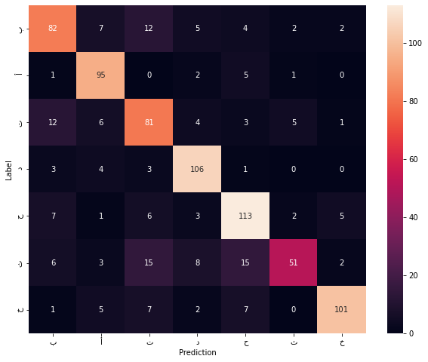
Vgg16 - without tuning

Slide 20
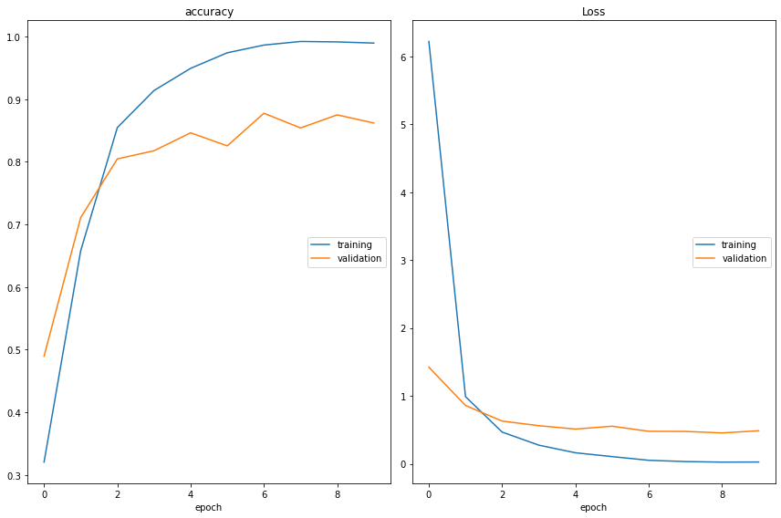
Vgg16 - with tuning
86% test accuracy

Slide 21
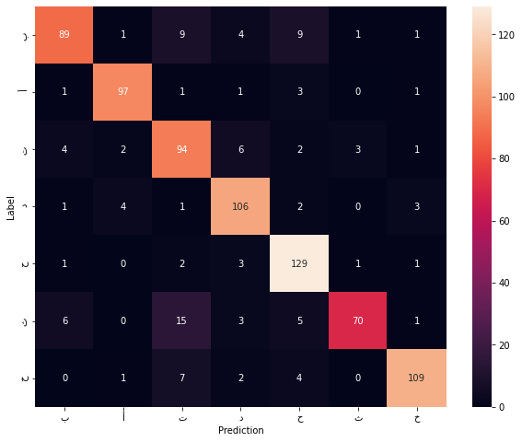
Vgg16 - with tuning

Slide 22
Challenges and difficulties
1
Small Data
2
Noise
3
Overfitting
22

Slide 23

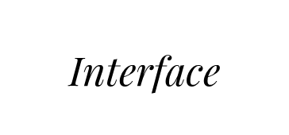

Place your screenshot here

Slide 24
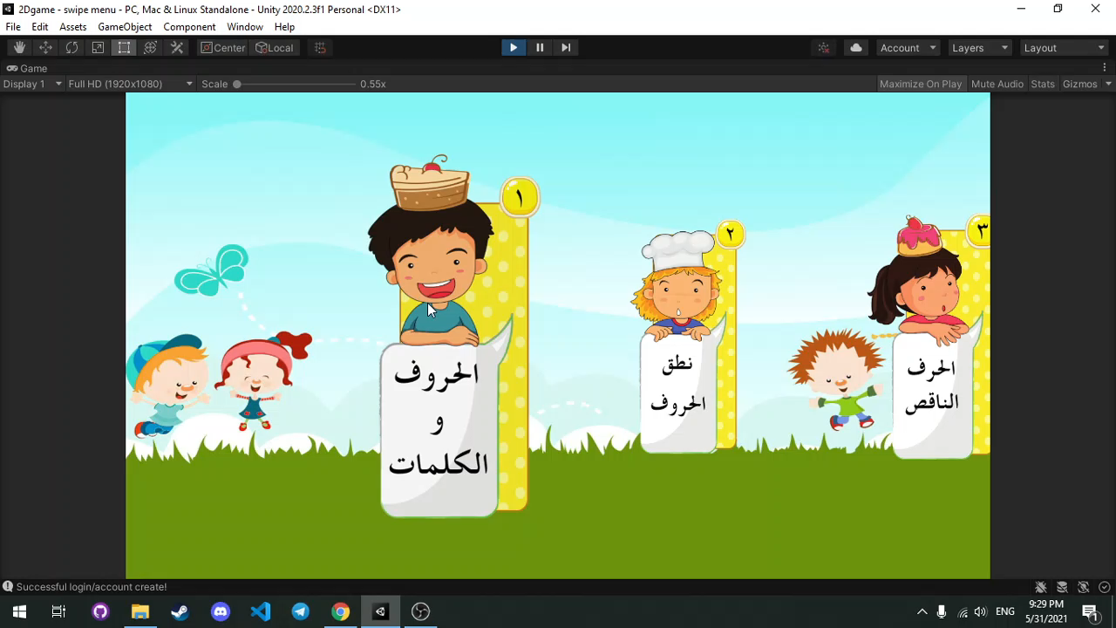

Slide 25

Any question?

